Slide 1
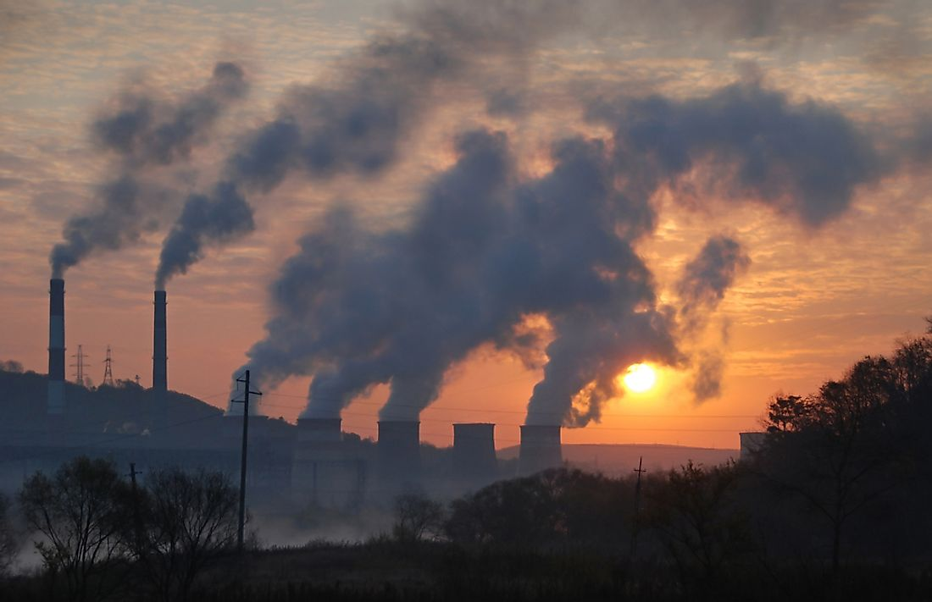
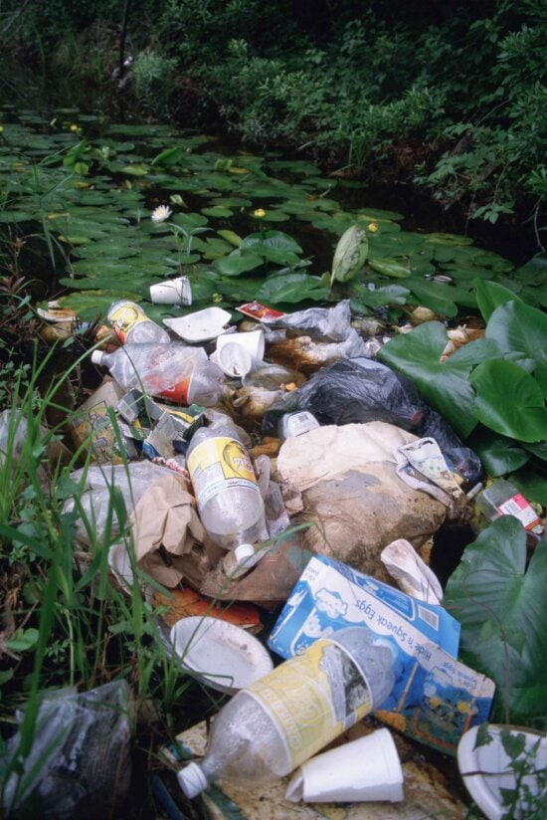
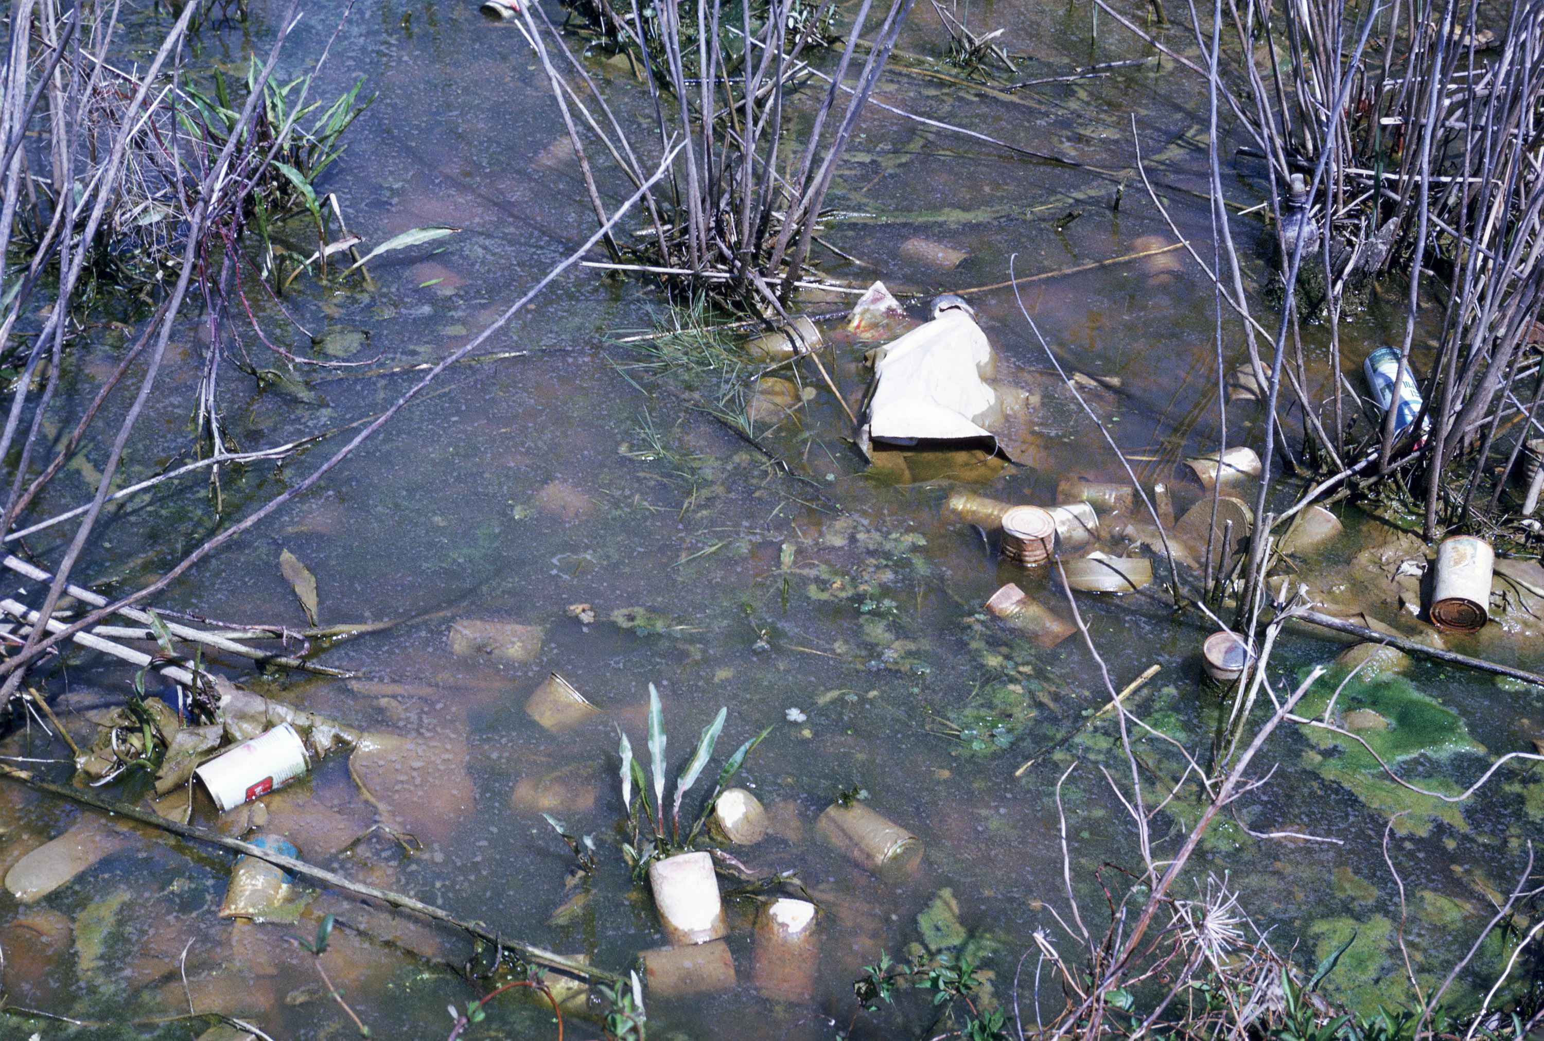
what is pollution
the presence in or introduction into the environment of a substance or thing that has harmful or poisonous effects:

Slide 2
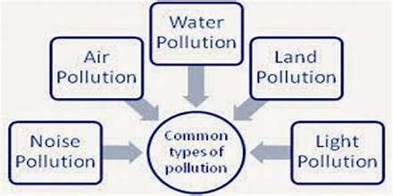
Types of pollution

Slide 3
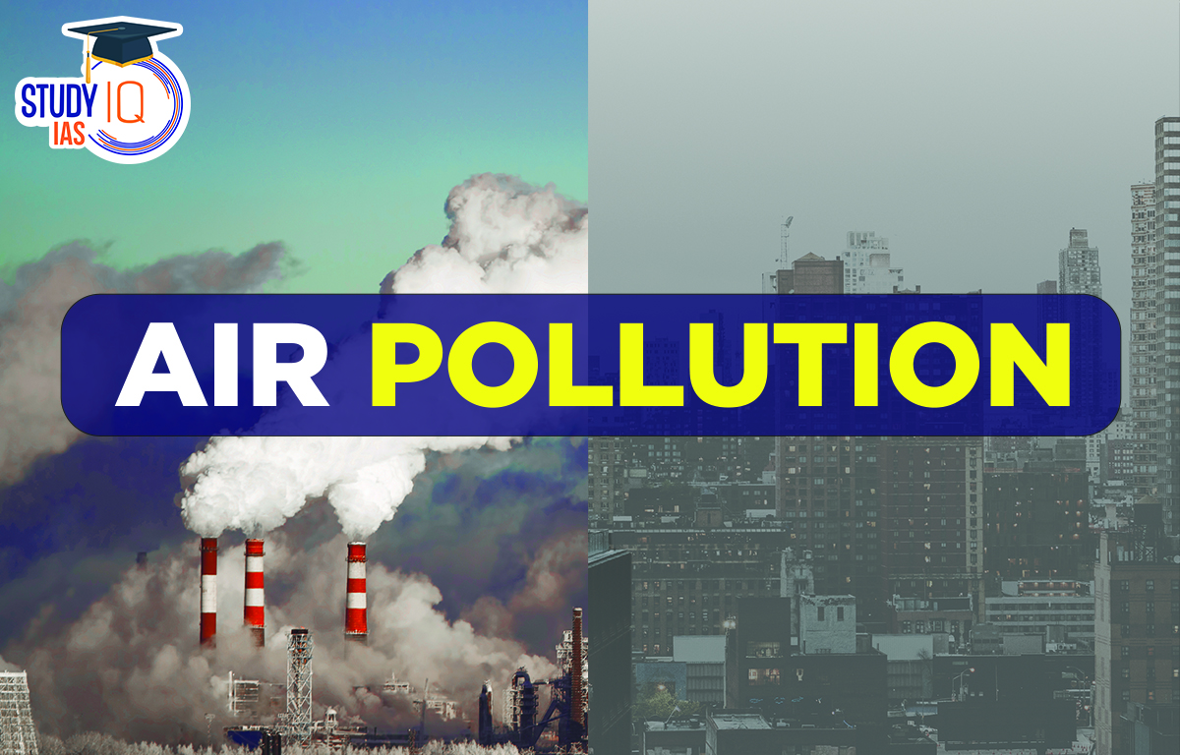
Air pollution
Air pollution is the contamination of air due to the presence of substances called pollutants in the atmosphere that are harmful to the health of humans and other living beings, or cause damage to the climate or to materials. It is also the contamination of the indoor or outdoor environment either by chemical, physical, or biological agents that alters the natural features of the atmosphere.

Slide 4
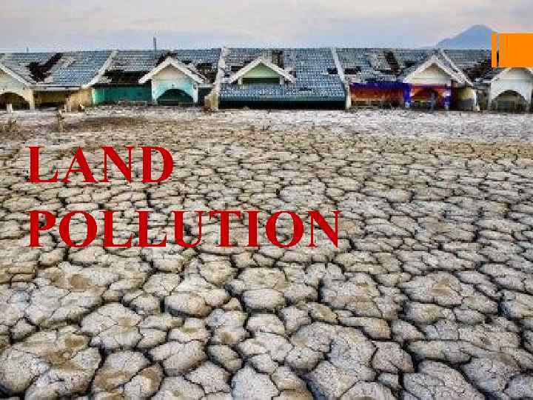
Land pollution
Land pollution, the deposition of solid or liquid waste materials on land or underground in a manner that can contaminate the soil and groundwater, threaten public health, and cause unsightly conditions and nuisances. The waste materials that cause land pollution are broadly classified as municipal

Slide 5
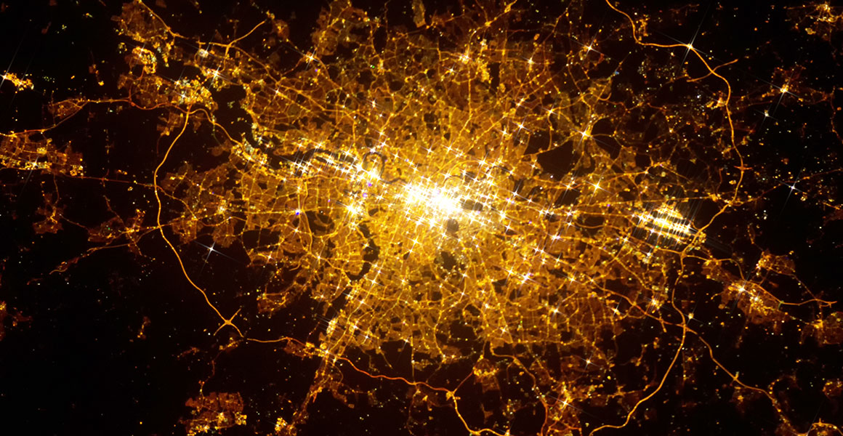
light pollution light pollution
As defined by the International Dark-Sky Association, light pollution refers to any inappropriate or excessive use of artificial light, which affects humans, wildlife, and the climate. Light pollution can be in the form of glare, skyglow, light trespass, or clutter.

Slide 6
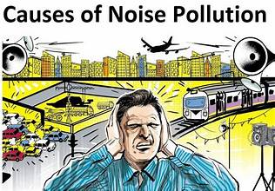
Noise pollution
noise pollution, unwanted or excessive sound that can have deleterious effects on human health, wildlife, and environmental quality. Noise pollution is commonly generated inside many industrial facilities and some other workplaces, but it also comes from highway, railway, and airplane traffic and from outdoor construction activities.

Slide 7
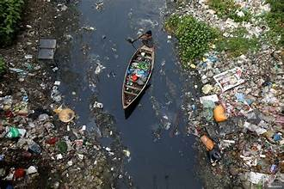
Water pollution
( See also wastewater treatment .) Water pollution is the release of substances (such as chemicals or microorganisms) or energy (in the form of radioactivity or heat) into surface and subsurface waters to the point that the substances interfere with beneficial use of the water or with the natural functioning of ecosystems.

Slide 8

Thank you

